Slide 1
Claims Centre of Truth
Secure access to device claim intelligence

Slide 2
The Problem
Fragmented Claims Create Invisible Fraud
Insurers operate in silos
Devices move between insurers with no shared memory
Duplicate claims are only discovered after payout (if ever)
Salvage recovery is slow, manual, and often skipped
The same stolen device can be paid out multiple times across insurers.

Slide 3
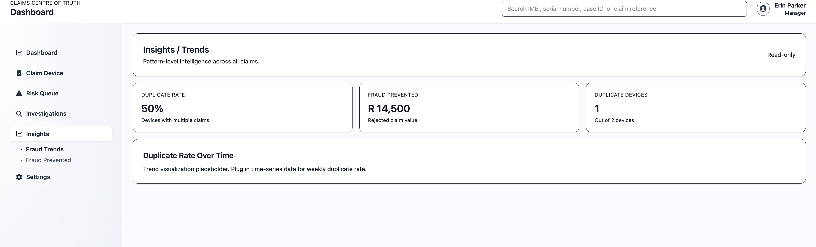
The Solution
Claims Centre of Truth (CCT)
A shared, device-centric claims memory
Anchored on IMEI and serial number
Append-only, auditable, POPIA-safe
Real-time duplicate detection before payout
Fraud is stopped before money leaves the system.

Slide 4
How It Works
Insurer submits claim outcome event
CCT records immutable device history
Future claims are checked instantly
Duplicates trigger risk signals
High-risk cases open investigations
CCT turns claims history into preventative intelligence.

Slide 5
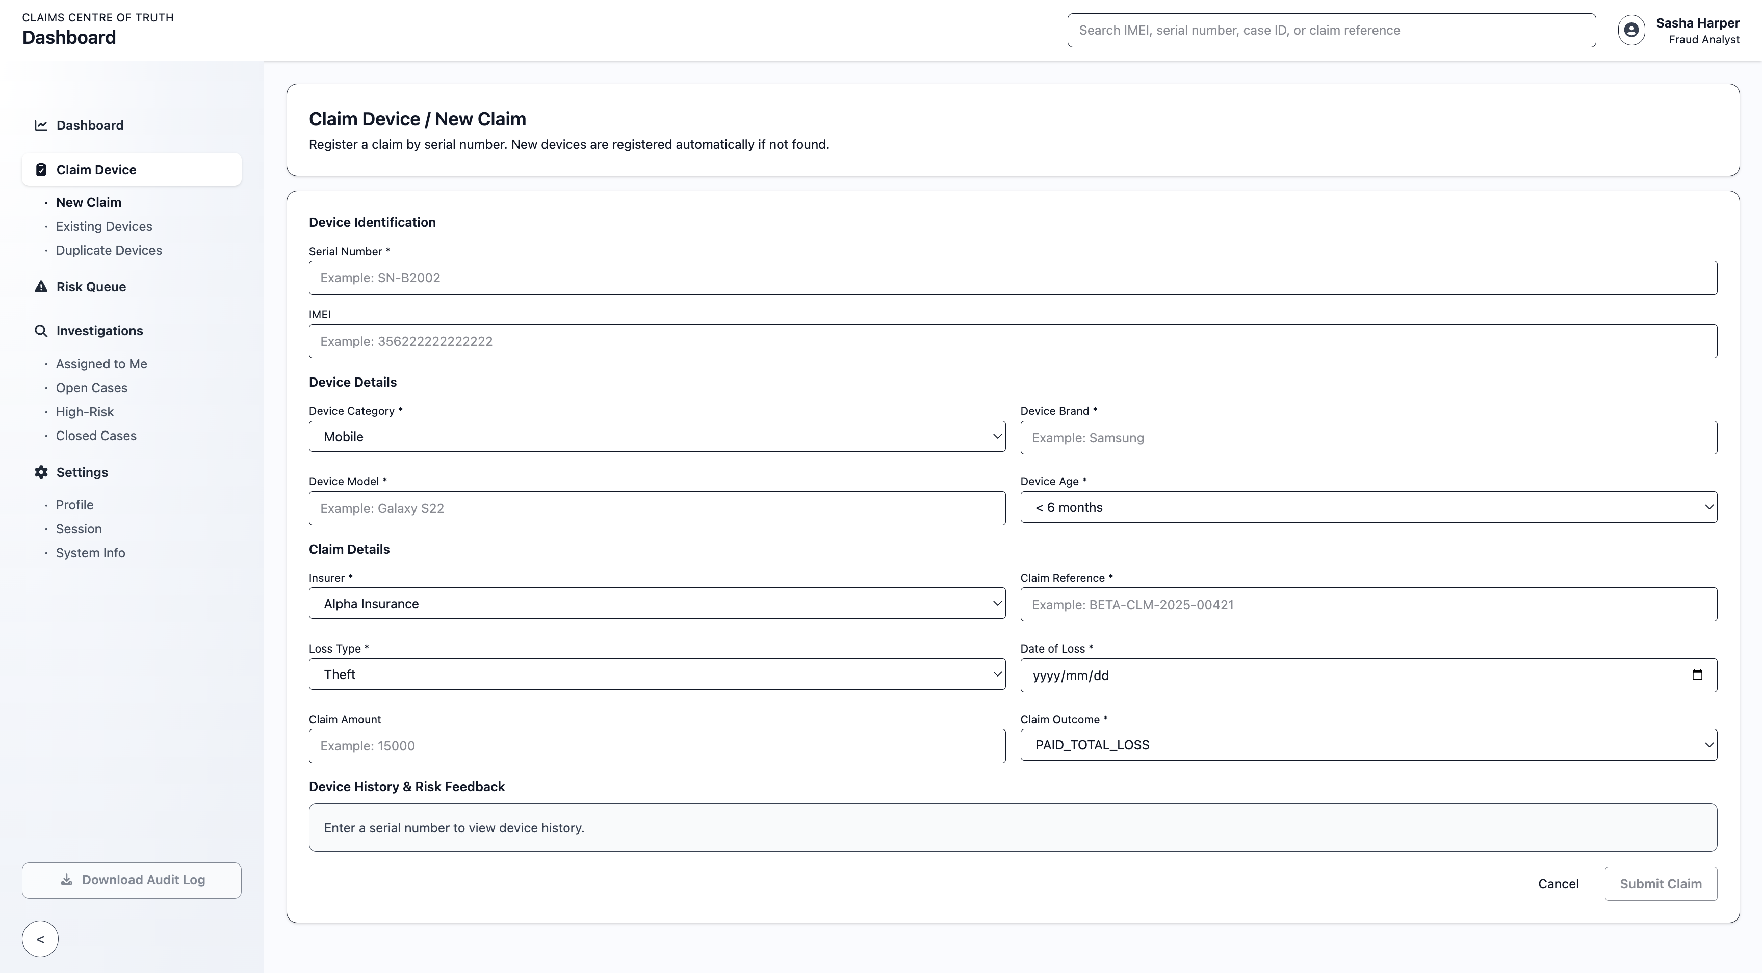
Live Demo: New Claim
Claim submitted using serial number
Device auto-registered if new
System checks prior history across insurers
What the audience sees:
“This happens before payout.”

Slide 6
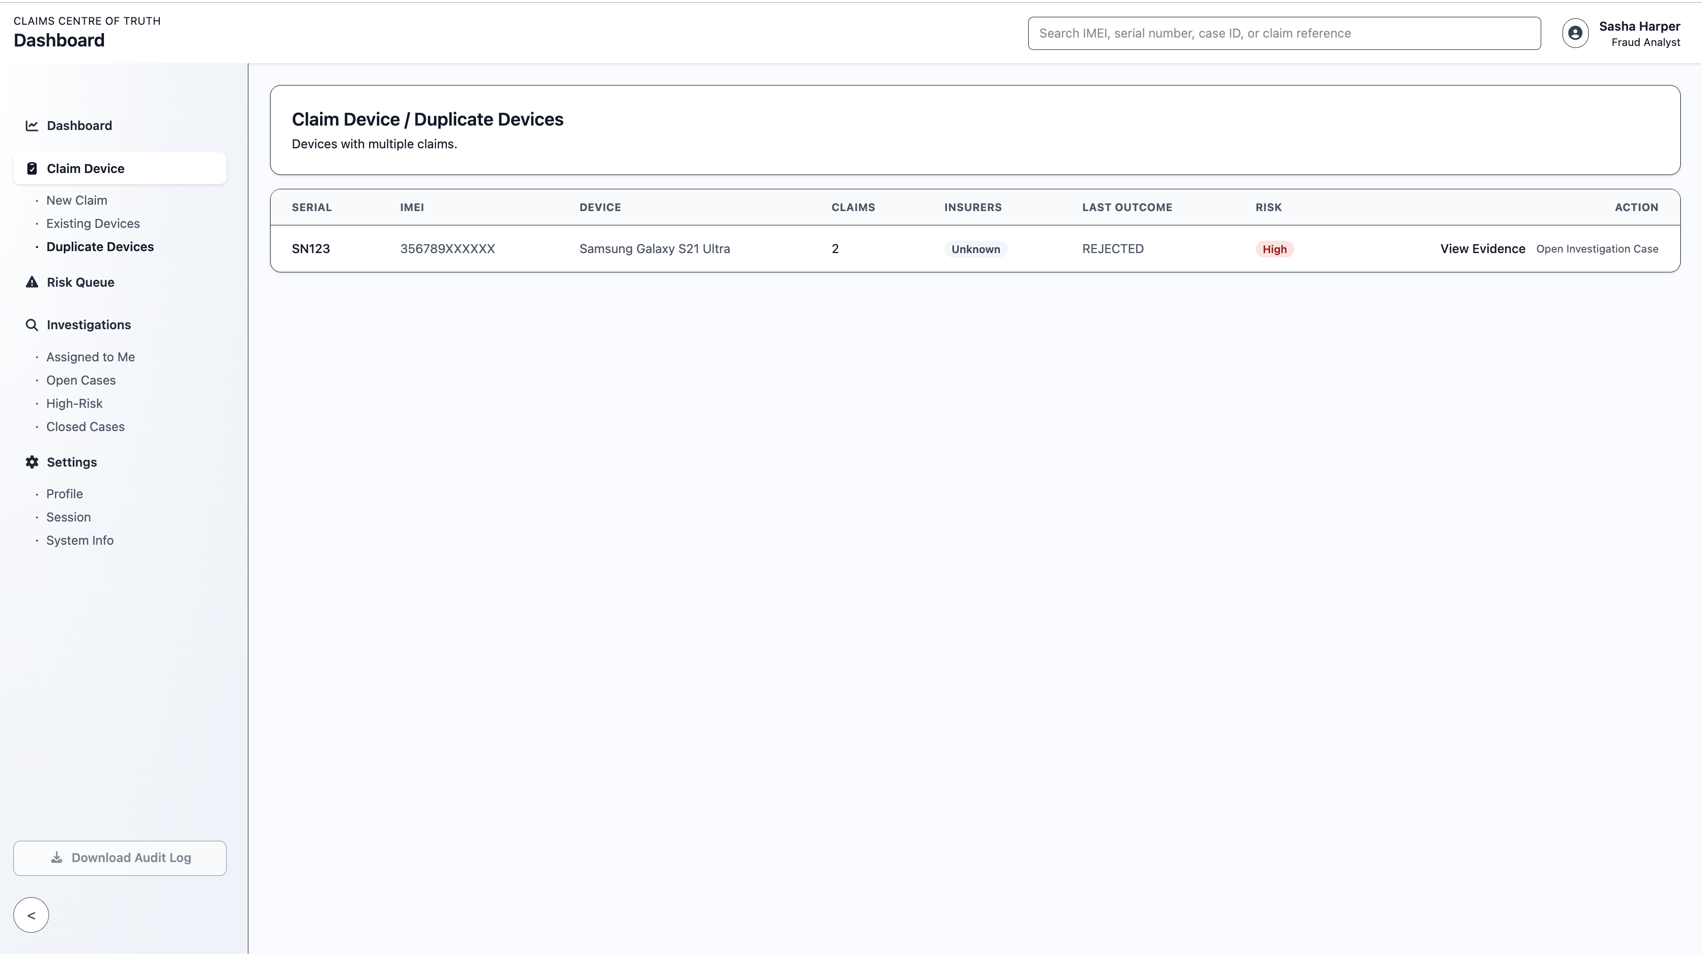
Duplicate Detected
Prior claim found for same device
Claim is auto-flagged
Risk signal raised
Claim can be rejected instantly
Key Line:
This is the exact moment fraud is prevented.

Slide 7
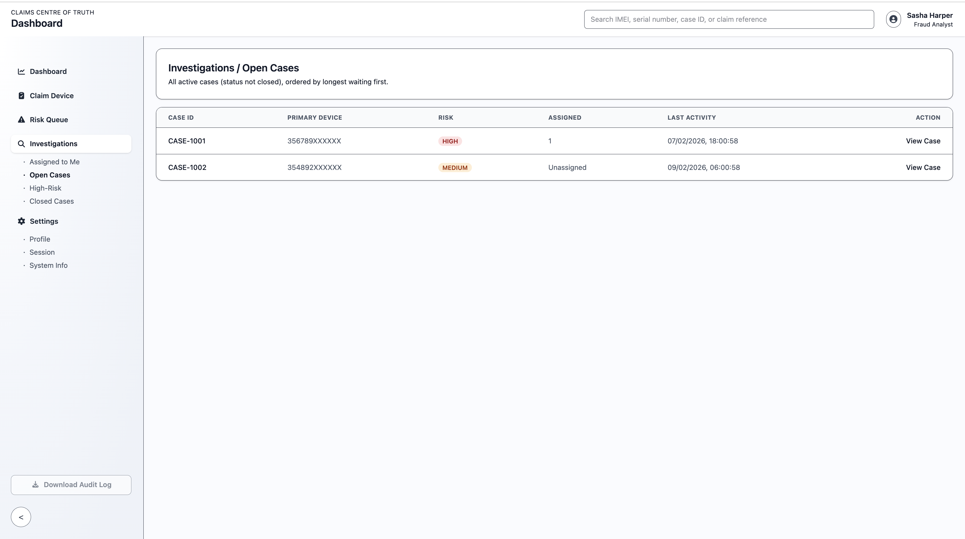
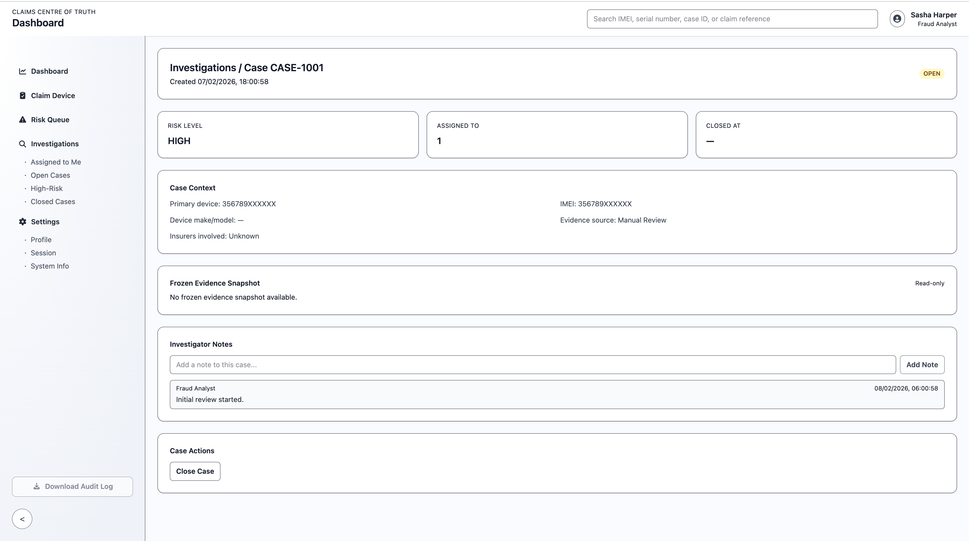
Investigation Workflow
High-risk signals open cases automatically
Cases are assigned and prioritised
Full device and claim history visible in one view
Benefit:
Investigators focus only on cases that matter.

Slide 8
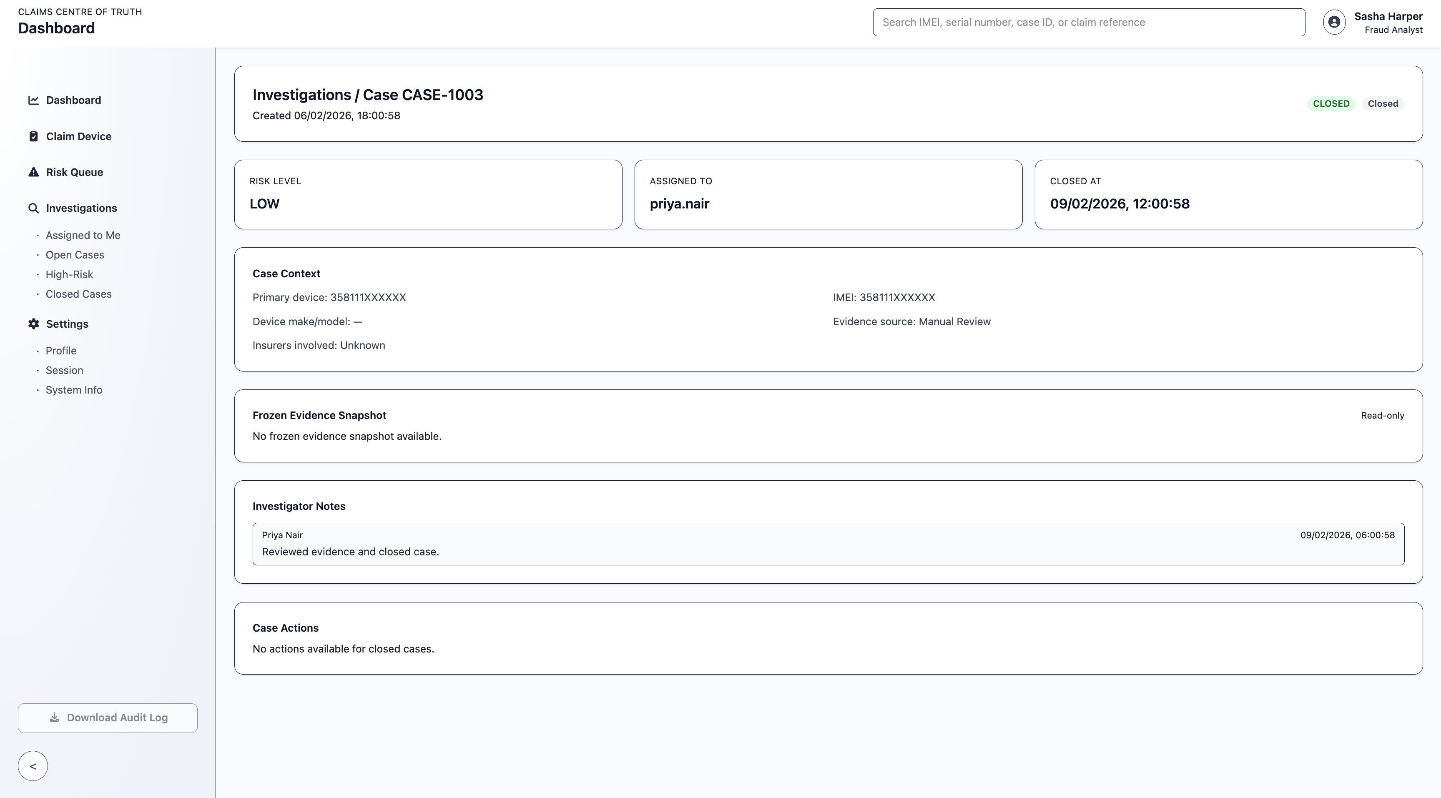
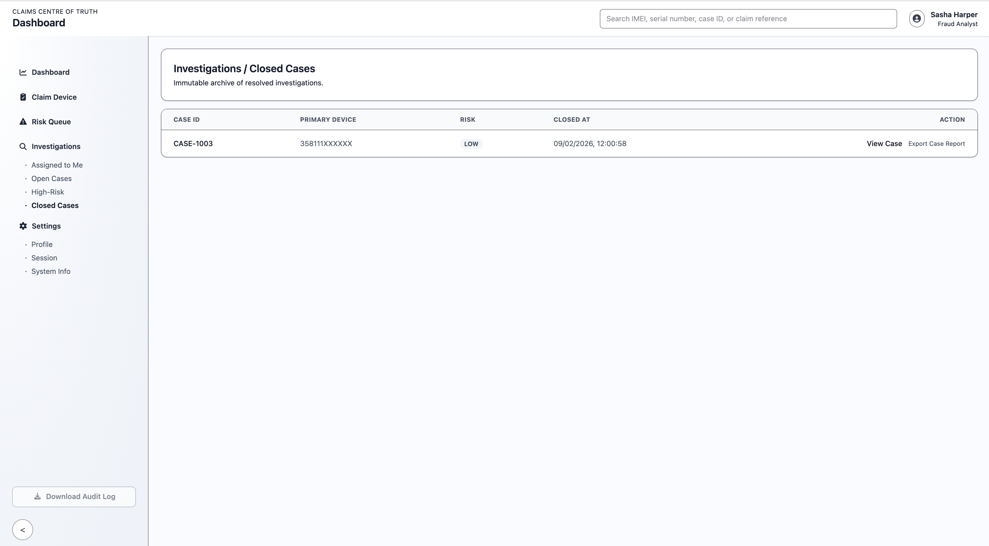
Audited Closure
Case closed with justification
Decision is immutable
Full audit trail recorded
Why it matters:
Every decision is defensible. Internally and externally.

Slide 9
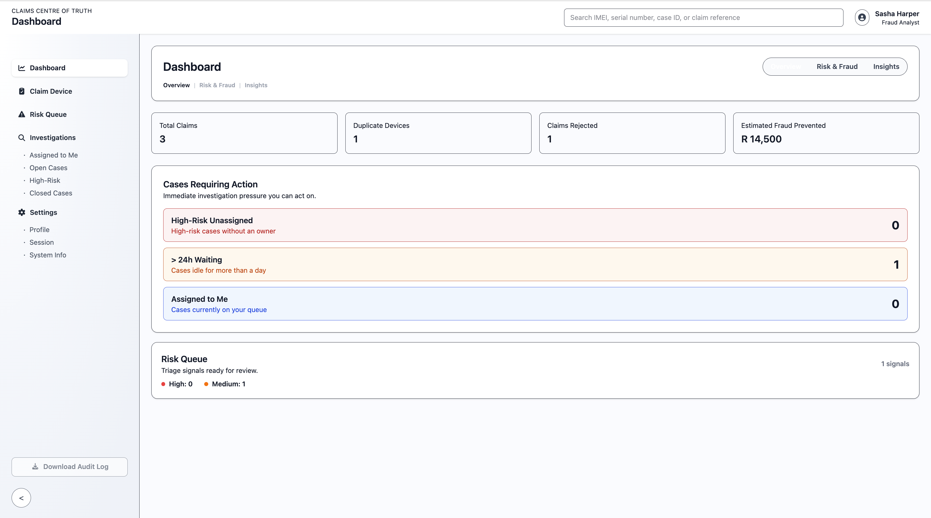
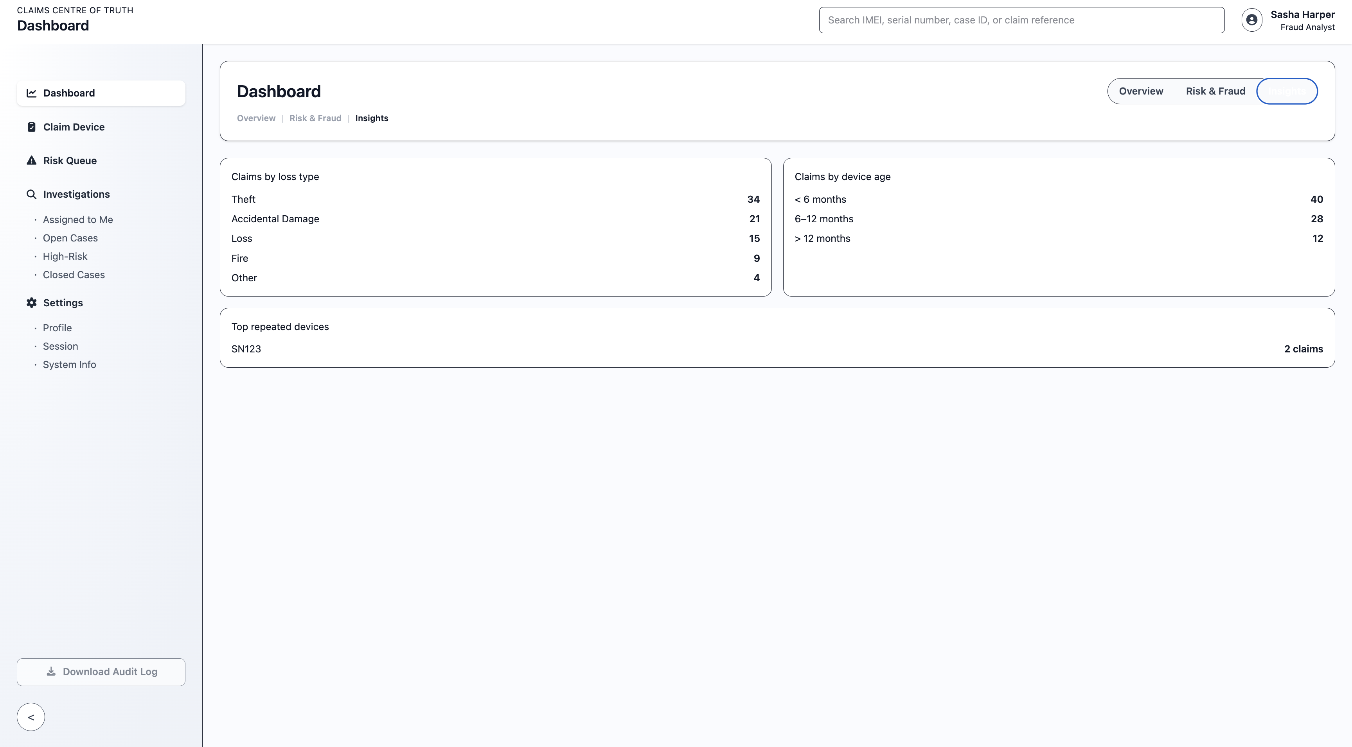
The Result
Duplicate claims prevented
Faster investigations
Shared industry intelligence
Measurable fraud reduction
Closing Line:
CCT doesn’t replace insurers, it strengthens them.

Slide 10
Before CCT
Scenario:
Phone stolen in Johannesburg
Insurer A pays out R15,000
Device re-enters market
Policyholder insures device again
Insurer B pays out another R14,500
Reality:
No shared visibility
No early warning
Fraud discovered too late (if at all)
Result:
Same device, paid twice. No recovery.

Slide 11
After CCT
Same scenario, different outcome:
Insurer A pays claim → event logged
Device history recorded in CCT
Same device claimed at Insurer B
CCT detects prior payout instantly
Claim flagged as duplicate
Claim rejected before payment
Investigation opened automatically
Result:
Fraud stopped. Money never leaves the system.

Slide 12
After CCT, fraud is prevented before payout.”
“Before CCT, fraud is discovered after payout.

Slide 13
Before CCT, fraud is discovered after payout.
After CCT, fraud is prevented before payout.

